Slide 1
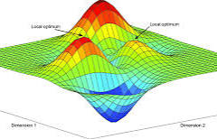
The synthetic fitness landscape of a binary genome
Evolution through programming, presentation of Ex 5
Sarit Moses and Itamar Nini

Slide 2
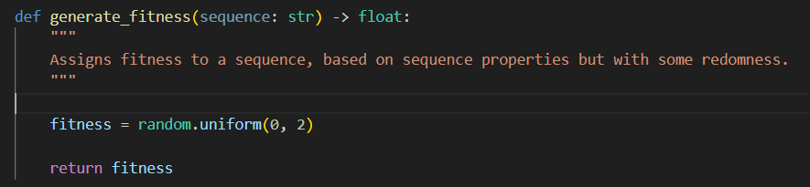
The Model
Generate all possible sequences
Assign random fitness to each of them
Randomly pick “founder sequence” to assign 1.0 frequency
Change frequencies over generations using the quasispecies equation
Notes:
Talk about the signal in each of these – CBASS cyclic oligonucleotides, Pycsar cyclic single nucleotides, thoeris and cleavage into adpr isomers
Mention they are all 2-gene systems

Slide 3
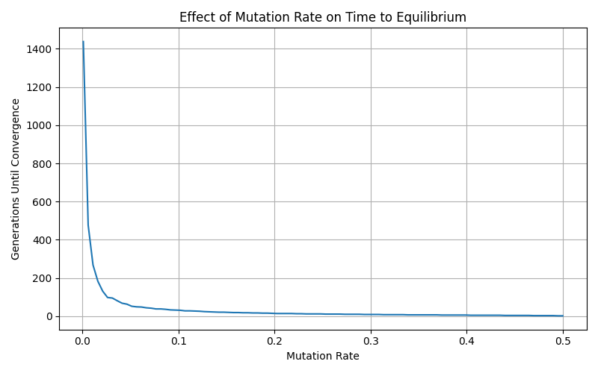
Time to convergence is shorted with more mutations per genome
Len=5

Slide 4
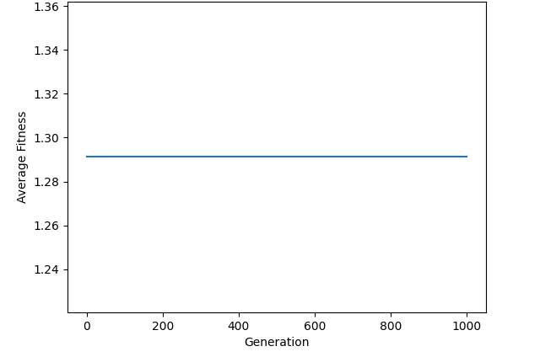
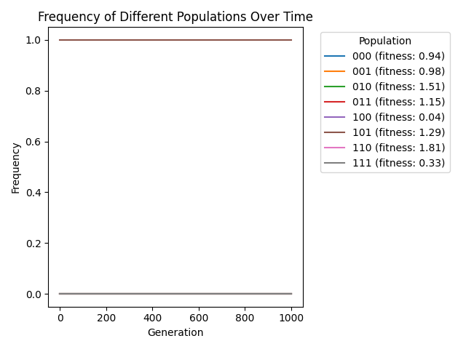
Fixed average fitness depends on mutation rate
Fitness (q=0)
Frequency of species (q=0)

Slide 5
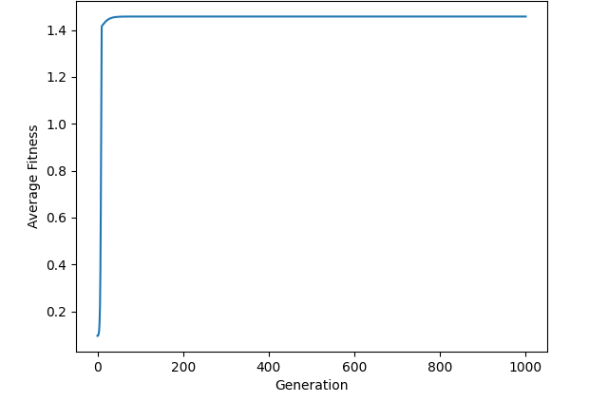
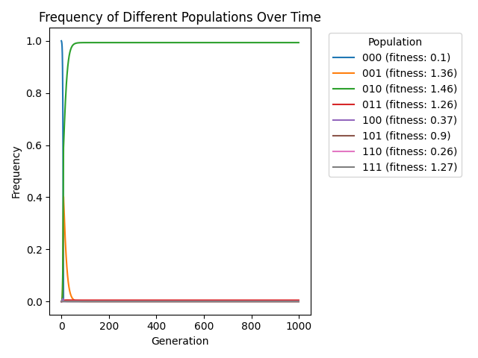
Fixed average fitness depends on mutation rate
Fitness (q=0.001)
Frequency of species (q=0.001)

Slide 6
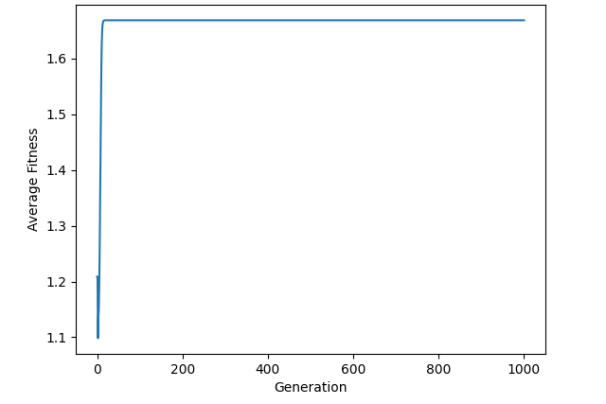
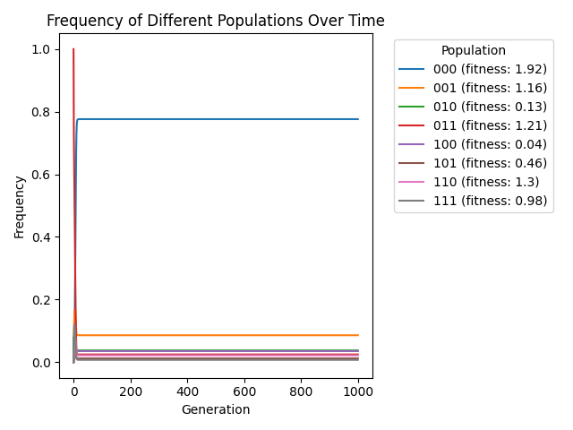
Fixed average fitness depends on mutation rate
Fitness (q=0.1)
Frequency of species (q=0.1)

Slide 7
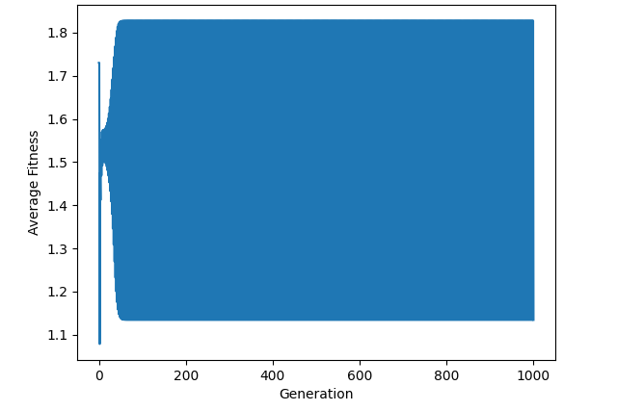
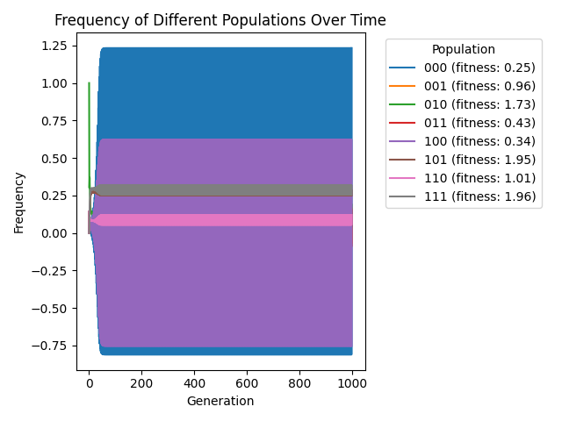
Fixed average fitness depends on mutation rate
Fitness (q=0.33)
Frequency of species (q=0.33)

Slide 8


